Slide 1
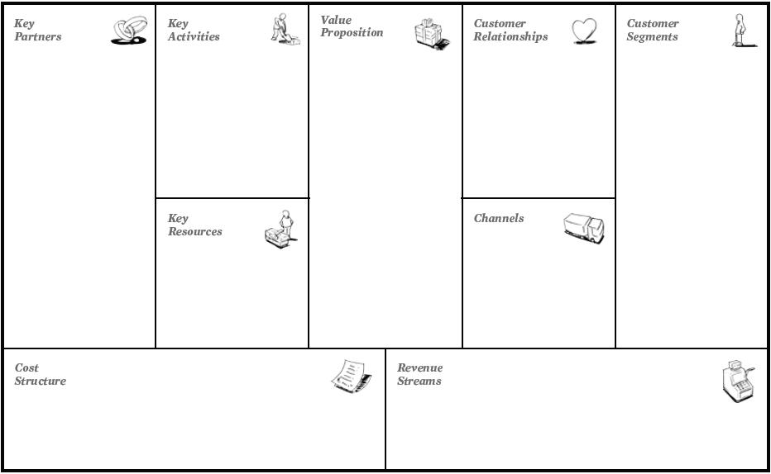
Bus
Shops inside metro
Park & Ride
Bike & Ride
Low cycle of waiting time
Fast and environment friendly travel
Public Transportation
Automated/nonautomated
Impersonal/ personal
(depending of the station you can have differente combinations)
Workers
Studing
Ocasional users
Turists
Publicity companies(?)
Email
Social media
Tv
App/ webSite
Maintece
Scurity
HelpCenter(ticket office, lost and found)
Tickets
Publicity

